Slide 1
LIBRARY CATALOGS:
CofC Lib Catalog, PASCAL Cat, and WorldCat
Dongmei Cao
10/22/2008
class blog: http://lib105fall08.blogspot.com/

Slide 2
In this lecture, we’ll discuss
CofC library catalog
PASCAL Cat (and PASCAL Delivers)
WorldCat (and InterLibrary Loan)

Slide 3
What is a library catalog?
an online database that provides the citations and locations of all materials in a library
Various library catalogs:
  different look (menus, record displays, commands)
  same structure, principles
made up of bibliographic records
  bib. record: detailed descrip. of a book or other lib materials

Slide 4
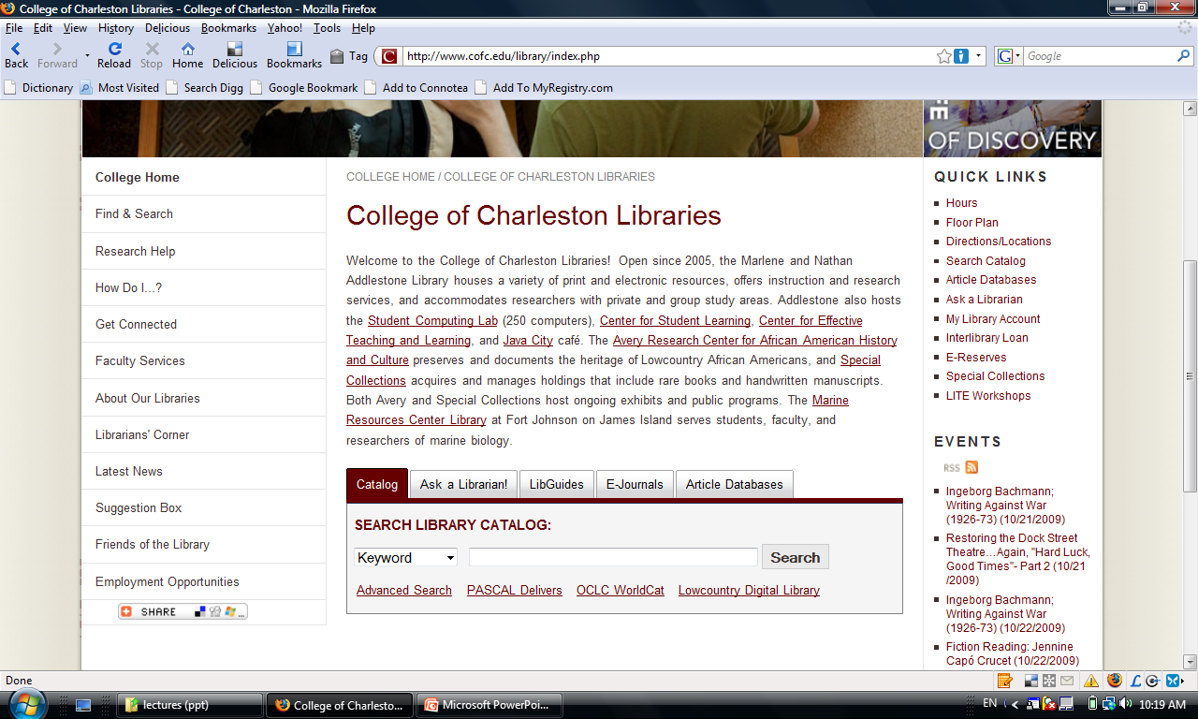
CofC Lib Catalog

Slide 5
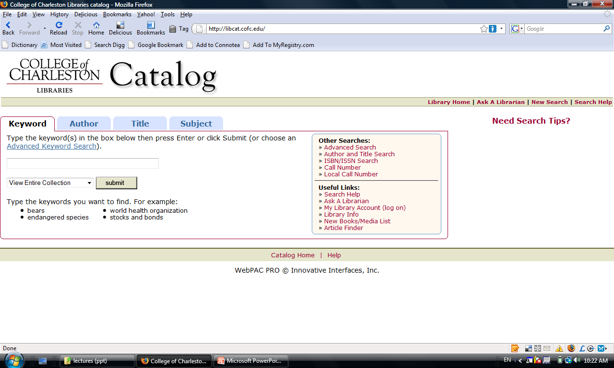
CofC Lib Catalog

Slide 6
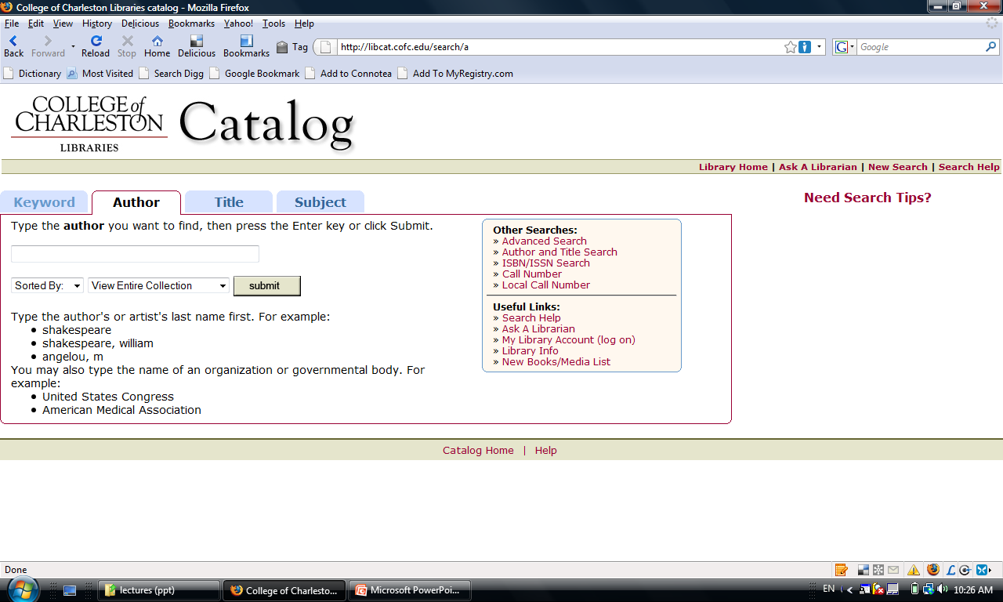
CofC Lib Catalog
Each type of search comes with tips for effective searching.

Slide 7
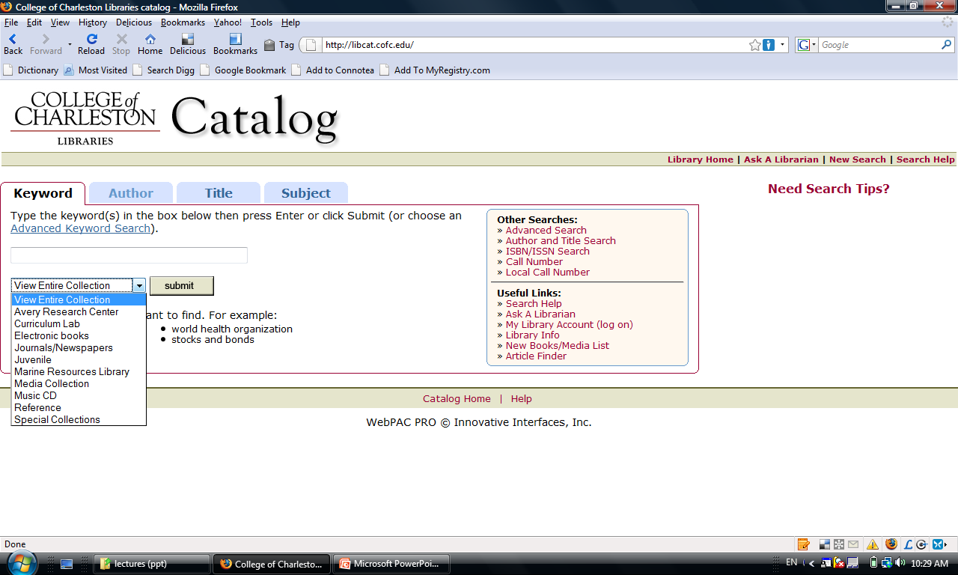
CofC Libraries Catalog
You can limit your search to a particular library, or parts of the libraries’ collections

Slide 8
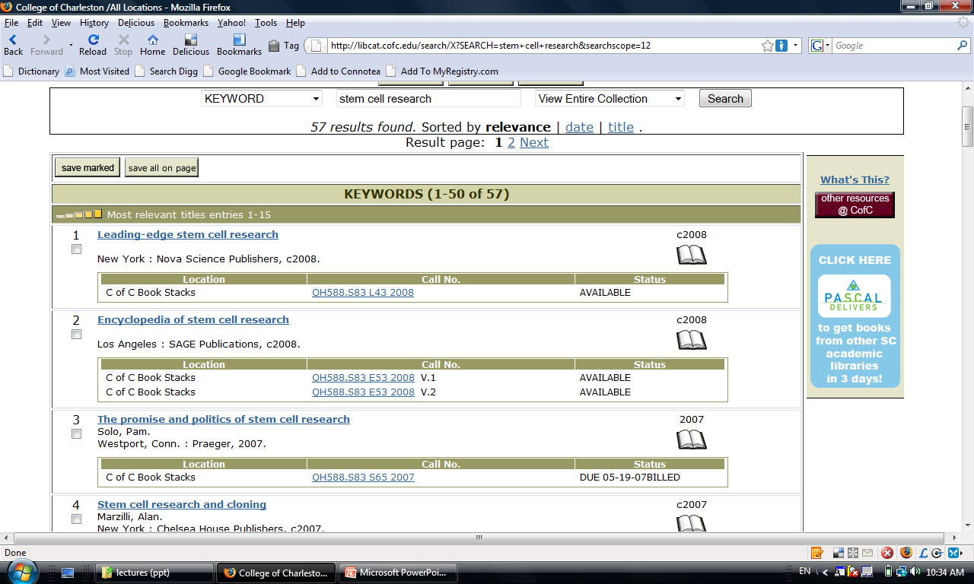
A list of search results
title
publication info
author(s)
Location, call number & status

Slide 9
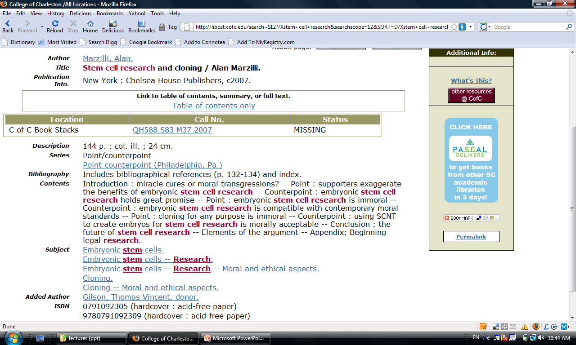
One bib. Record (detail)
link(s) to more info online
physical description
contents (not always avail.)
LC subject headings – link you to similar items on the subject

Slide 10
CofC lib catalog: a recap
title
  sometimes, a subtitle after a colon
author(s)/editor(s)
  corporate author
pub. info
  city, publisher, date of pub.
location/call number/status
phys. descrip.
  # of pp., # of ill., height
LC subject headings
fields not always avail.
  contents
  links to more info online

Slide 11
PASCAL Cat/ PASCAL Delivers
PASCAL: Partnership Among South Carolina Academic Libraries
A union catalog
Why?
  access to more resources
  resource sharing
PASCAL Delivers (service): 5-day turn around
Sept. 06, >4 million (item records)
About Pascal Delivers

Slide 12
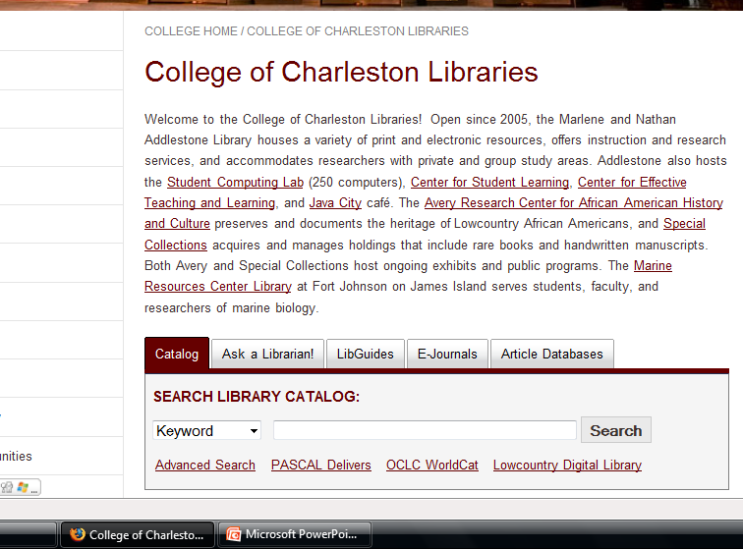
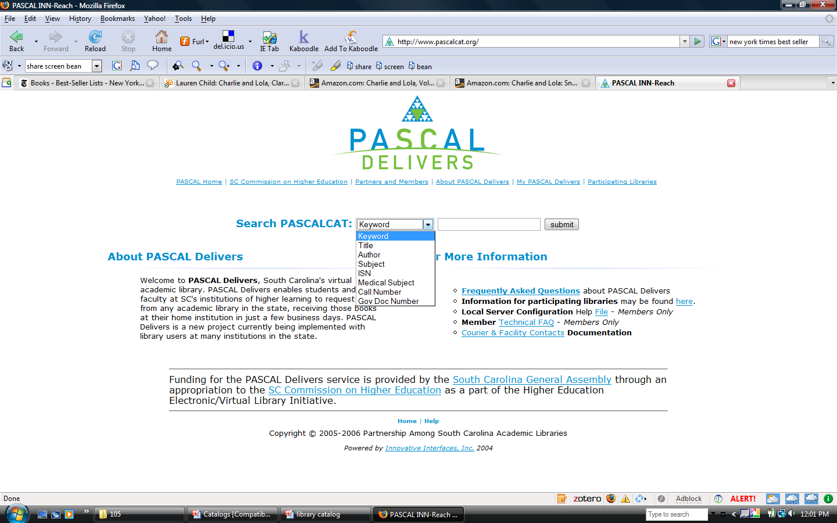

Slide 13
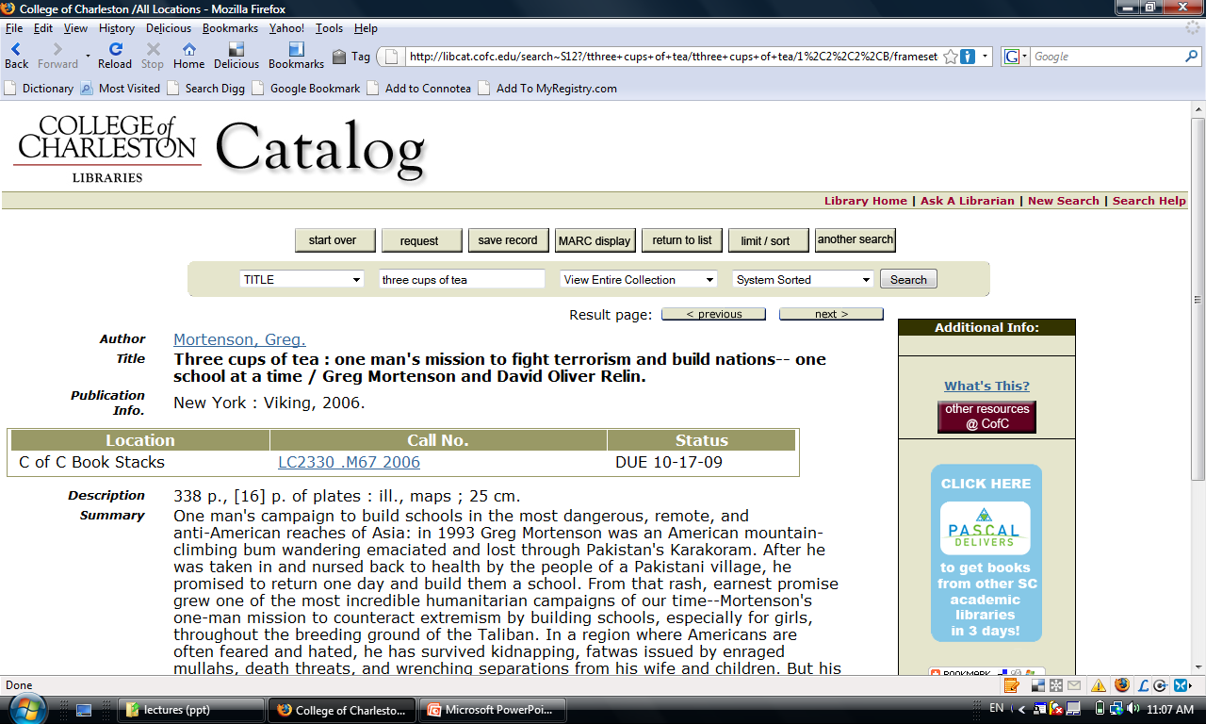
If a book is not available (e.g. checked out) at CofC Library, check PASCAL Cat to see if you can get it through PASCAL Delivers.

Slide 14
Hands on time …
Do a title search: Health care reform now
in our catalog
Click on the PASCAL Delivers logo
Click on “Display Holdings of PASCAL Libs”
Questions for you:
  Do we have this book in our catalog?
  How many PASCAL libs have the book available?
  Can you request the book through PASCAL Delivers if you need to?

Slide 15
WorldCat
the world’s largest library network
holdings of more than 10,000 libraries worldwide
Why:
  Resource sharing
  Access to more
Use ILL (InterLibrary Loan) to request books or articles

Slide 16
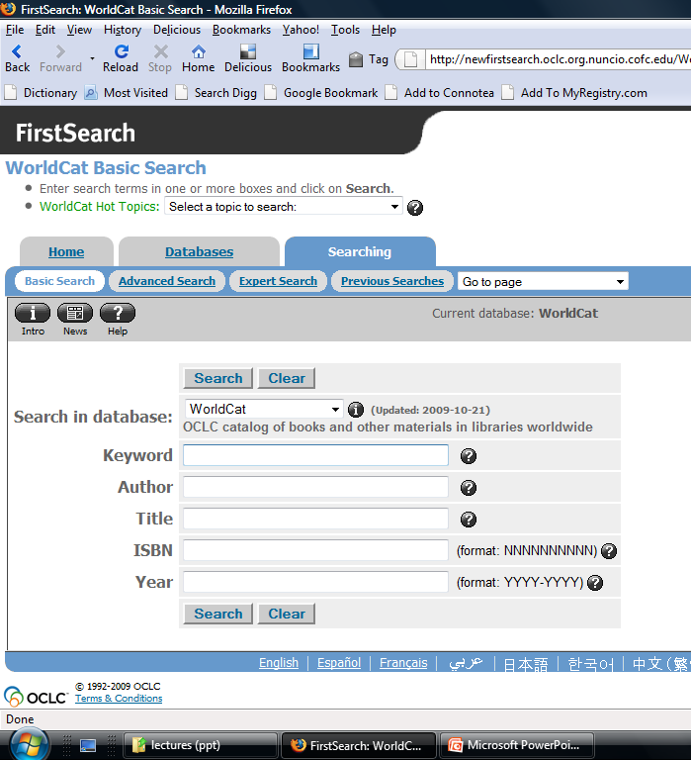

Slide 17
Hands on time … in WorldCat
Do a keyword search (in Basic Search mode):
harlem renaissance (How many book records do you get?)
Click on the Advanced Search tab
Search harlem renaissance as a phrase (keyword): “harlem renaissance” (How many book records do you get?)
Do a Subject Phrase search: harlem renaissance (How many book records do you get this time?)
Limit the above search to “Items in my library” (How many book records do you get?)

