Slide 1
Databases: search strategy (II)
    caod@cofc.edu
    http://lib105fall09.blogspot.com/

Slide 2
How do you know … which database?
general/multi-disciplinary:
covers a wide variety of disciplines
  e.g. Academic Search Premier: history, math, education, engineering, music, chemistry … and much more
subject specific:
focus on a single discipline and cover it more thoroughly
  e.g. Sociological Abstracts (sociology)

Slide 3
How do you know … which database?
To find the best database for your topic
Use the LibGuides (LibGuides for Majors & Minors)
Practice!
  repeated use, best way to learn the contents of databases (and search techniques).
Ask a librarian, recommend.

Slide 4
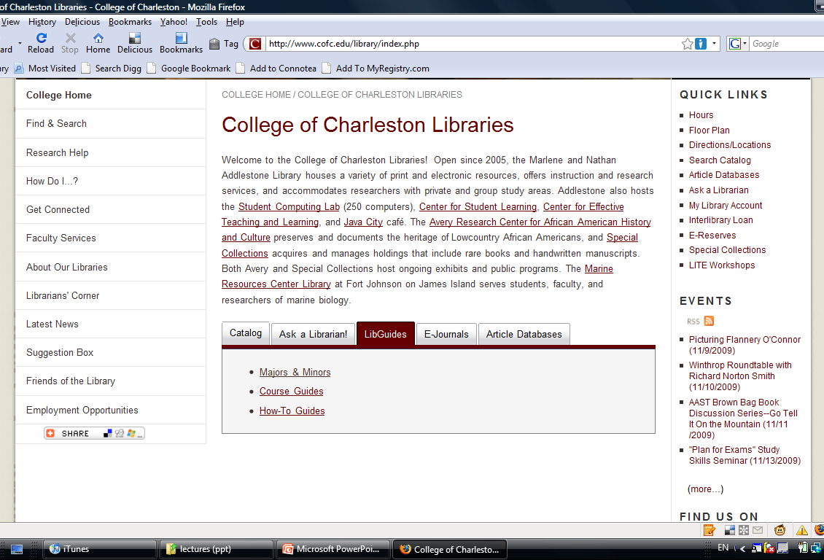
LibGuides for Majors & Minors (screenshot)

Slide 5
Reading Your Search Results
citations for books or
articles (journals, magazines, newspapers)
sometimes links to the items themselves,
  as in results #5, #6, and #7 of the following screenshot
  full-text

Slide 6
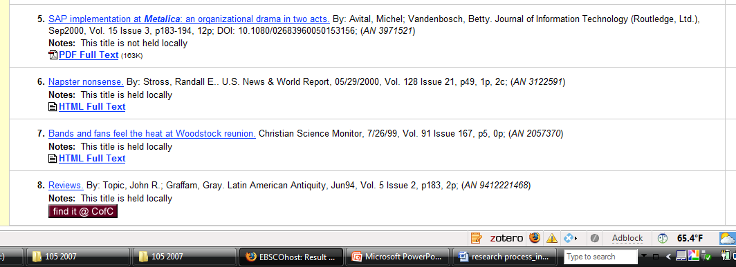

Slide 7
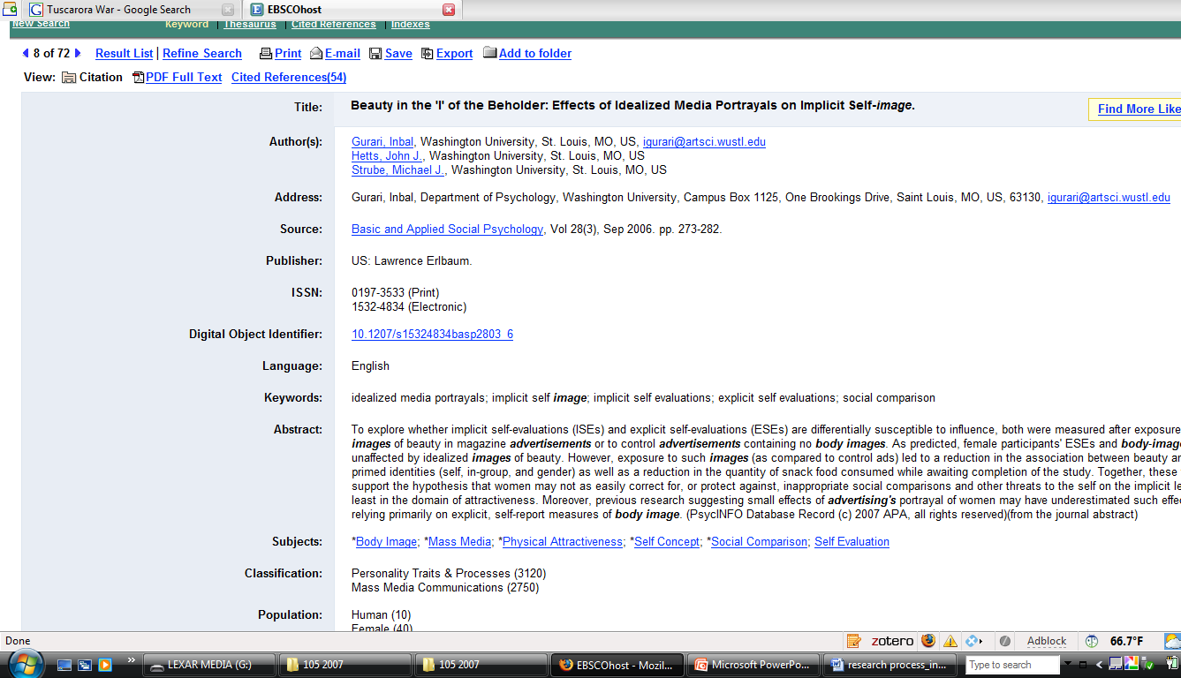
A journal article citation
article title
author(s)
journal title
vol., issue # & date

Slide 8
A journal article citation
Journal article citations look different from book citations.
Journal citations include a:
  article title
  author
  journal title
  date
  2006, Sep 2006,
  Winter 1998, 8/1/2003
  volume and issue number
  Vol. 28 Issue 3, or 28(3)
Note:
Source field does not include the publisher name or location.

Slide 9
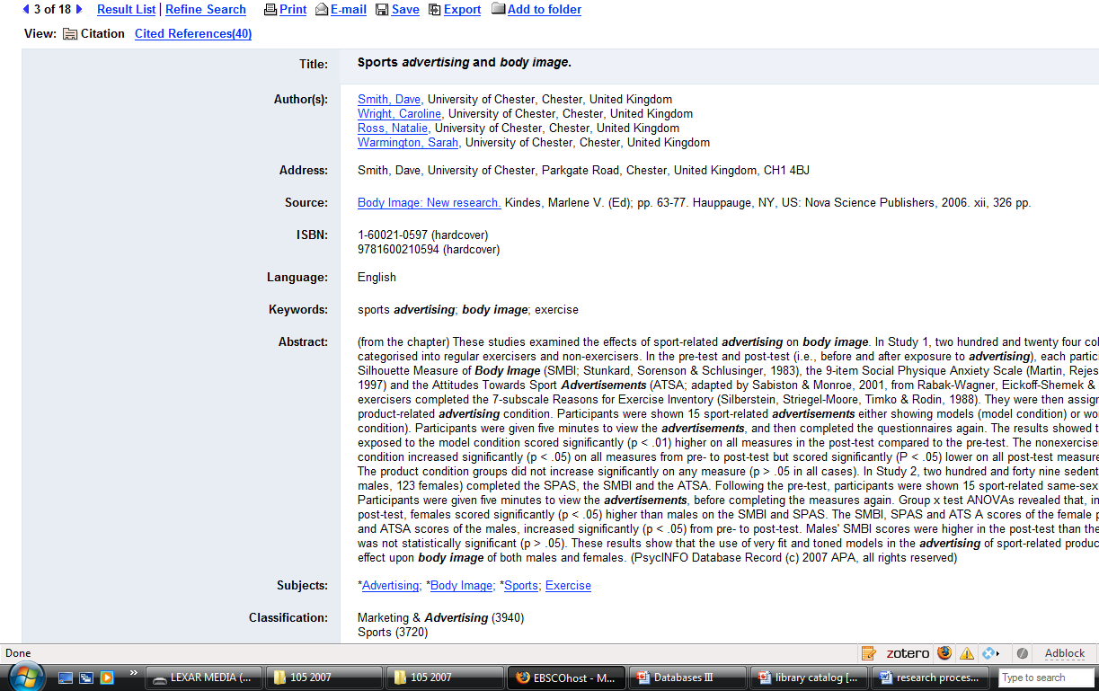
A book citation
chapter title
chapter author(s)
book title and book editor(s)/author(s)
Publisher info & pub. year

Slide 10
A book citation
book citations include a:
  chapter title
  chapter author(s)
  book title
  book editor(s) or author(s)
  publisher name and location
  publication year (no month or date)
Note: no volume or issue info
Many book citations do not include the chapter title or author.

Slide 11
Tips about searching
Suppose you get zero results.
  Check your spelling and retype any search that fails
  Try your search in several databases
  Try a different search strategy by using different keywords or different subject terms
  Check your strategy and search terms with a librarian or another searcher.
Experienced searchers never give up.
  it often takes several tries to find the info
no hard and fast rules: how much info is "enough".
  the list is manageable
  the items are relevant
  Then you’ve done a successful search!

Slide 12
Searching Process: review
Where you look matters!
  The database should match the topic.
How you ask matters!
  Different search terms yield different search results.
Pay attention to what works!
  Effective searchers learn from past experiences.

